Slide 1
BIOGEO CHEMICAL CYCLES
F Y B Sc

Slide 2
1. Cycle Component Concepts
Standard Concepts (Physical)
  Precipitation
  Evaporation/Evapotranspitation
  Surface Water
  Groundwater
Ecosystem & Use Related (Basin/Watershed Perspective)
  Green water (Terrestrial ecosystems, Crops, Wetlands)
  Blue water (Throughflow, Consumptive use & return flow)

Slide 3
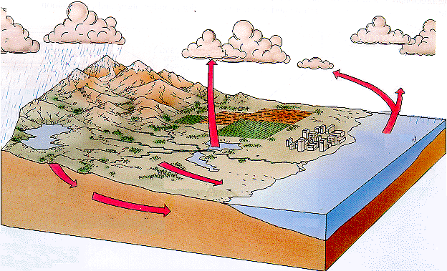


Basic Cycle
Precipitation
Evaporation
Evaporation (ET)
Evaporation
Ocean
Infiltration
runoff
Aquifer
Precipitation
Evaporation/ET
Surface Water
Groundwater

Slide 4
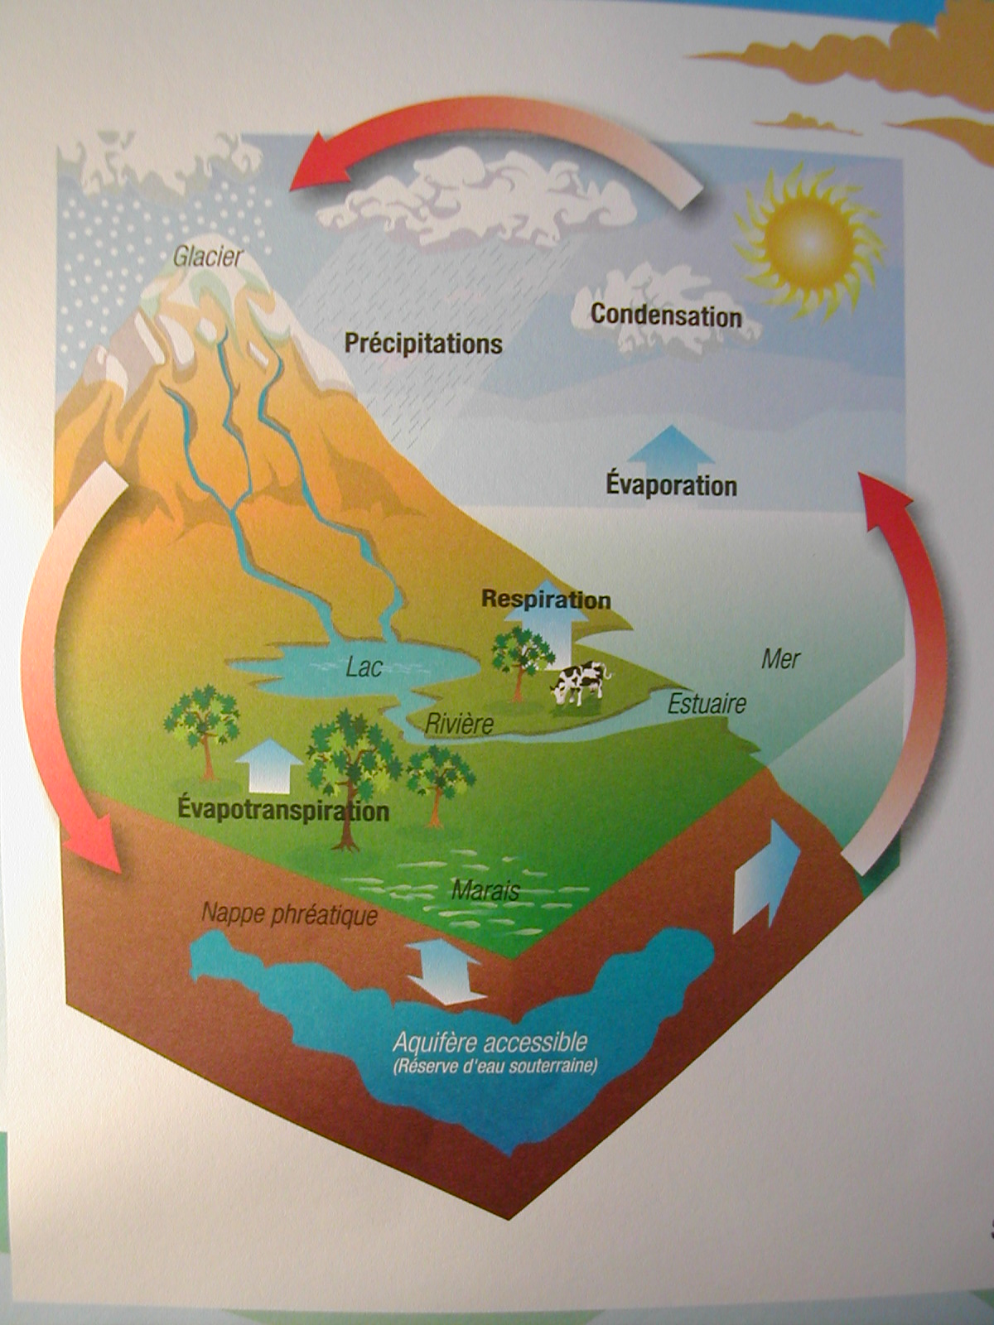
Basic Cycle

Slide 5
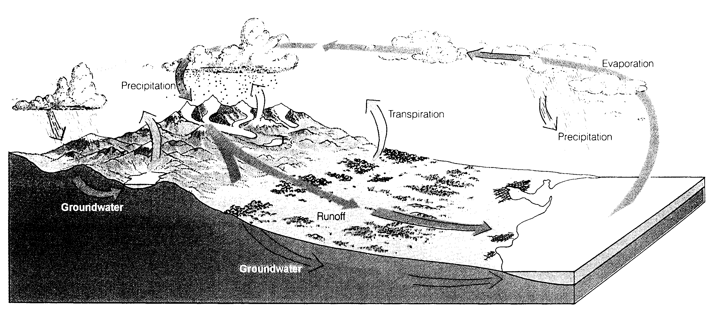
Basic Cycle

Slide 6
CYCLE COMPONENTS - Related
Groundwater
  Contamination Issues

Slide 7
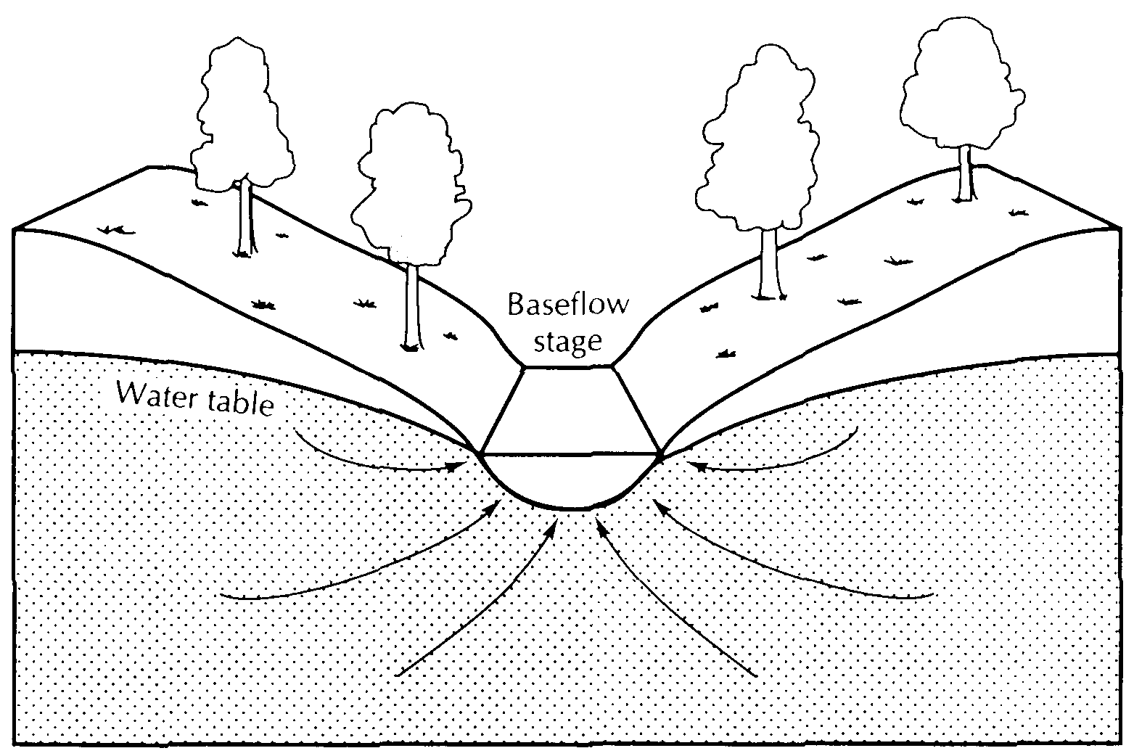
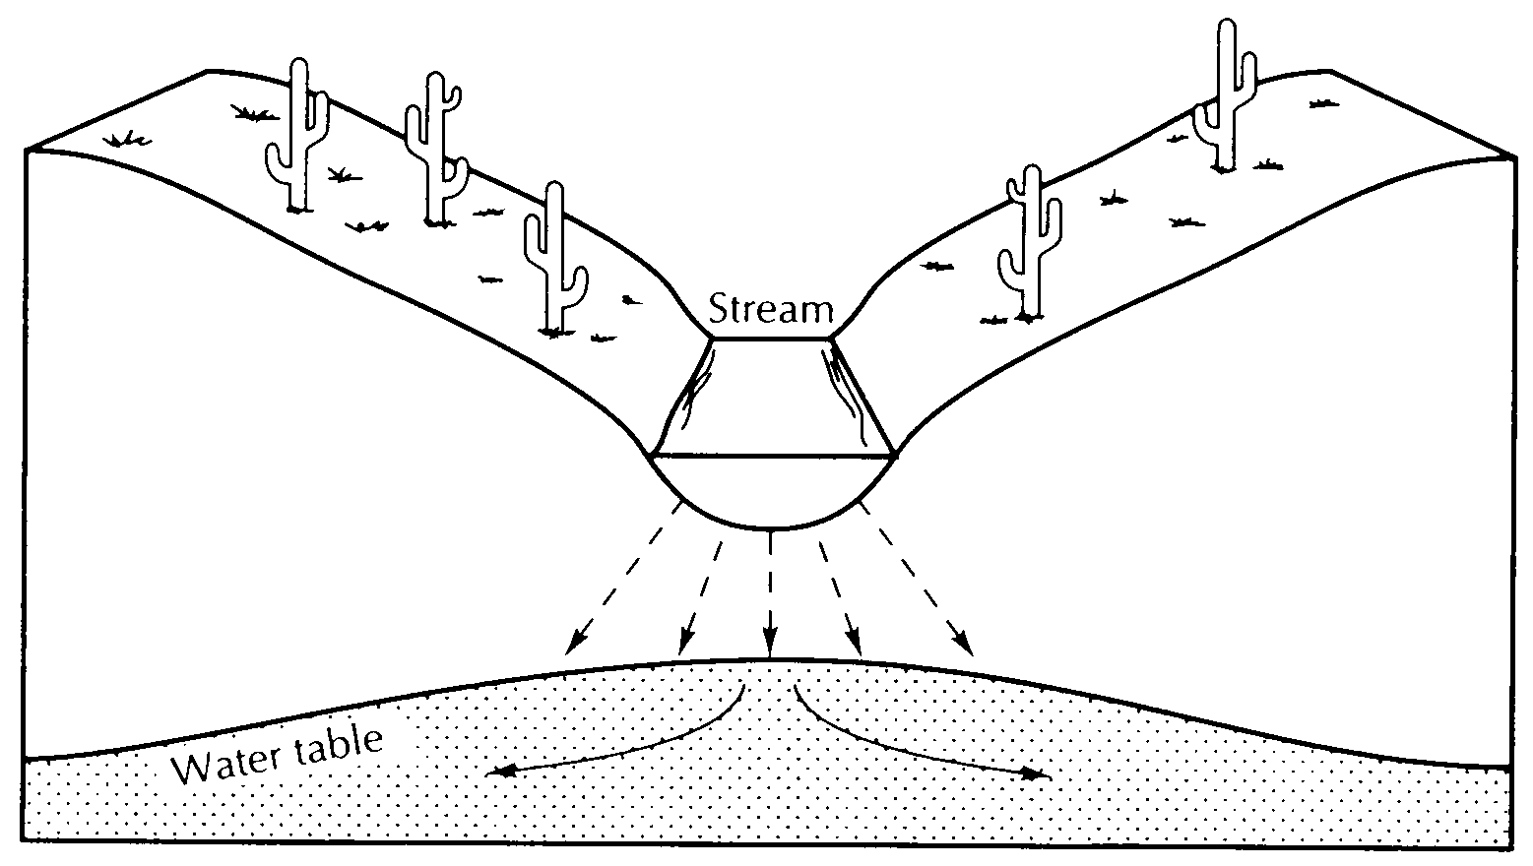
SW/GW relations - Humid vs Arid Zones
A. Cross section of a gaining stream, which is typical of humid regions,
where groundwater recharges streams
B. Cross section of a losing stream, which is typical of arid regions,
where streams can recharge groundwater

Slide 8
Basic Cycle
 | Temperate climate |  | Semi-arid climate |  | Arid climate
 | % | mm | % | mm | % | mm
Total precipitation | 100 | 500 - 1500 | 100 | 200 - 500 | 100 | 0 - 200
Real evapotranspiration | ~ 33 | 165 - 495 | ~ 50 | 100 - 250 | ~ 70 | 0 - 140
Groundwater recharge | ~ 33 | 165 - 495 | ~ 20 | 40 - 100 | ~ 1 | 0 - 2
Surface runoff | ~ 33 | 165 - 495 | ~ 30 | 60 - 150 | ~ 29 | 0 - 58
Approximate annual hydrological budget

Slide 9
1. Cycle Component Concepts
Standard Concepts (Physical)
  Precipitation
  Evaporation/Evapotranspitation
  Surface Water
  Groundwater
Ecosystem & Use Related (Basin/Watershed Perspective)
  Green water (Terrestrial ecosystems, Crops, Wetlands)
  Blue water (Throughflow, Consumptive use & return flow)

Slide 10
Blue & Green Water - perspective
Precipitation – the basic water resource
GW
GW
GW
GW
GW
Adapted from: GWP (M. Falkenmark), 2003, Water Management and Ecosystems: Living with Change
Notes:
Add green to show where the areas are blue and green
- see if there could be a separate wet and dry example....

Slide 11
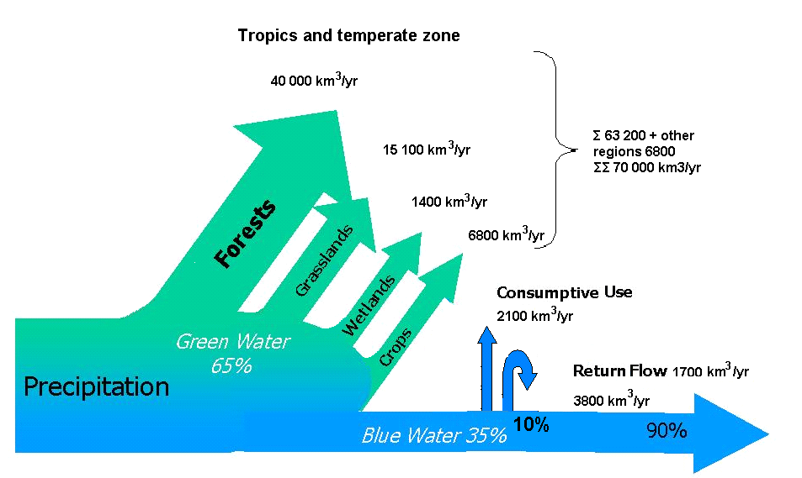
Blue & Green Water – Pathways
percentages
Consumptive water use by terrestrial ecosystems as seen in a global perspective. (Falkenmark in SIWI Seminar 2001).

Slide 12
More Detailed Cycle Components
Precipitation
Evaporation
Evapo-transpiration
Evaporation
Ocean
Infiltration
Recharge
runoff
Aquifer
Precipitation
Evaporation/ET
Surface Water
Groundwater
Notes:
show main component
add man-made modifications
show change in the hydrologic cycle –
now restore parts of it
red piping – a
add dam

Slide 13
WHAT ARE OTHER COMPONENTS
IN THE CYCLE TODAY?

Slide 14
More Detailed Cycle Components
Precipitation
Evaporation
Evapo-transpiration
Evaporation
Discharge
treated water
Soil
moisture
Soil moisture
Water
Supply
Ocean
Infiltration
Recharge
runoff
Extraction
Aquifer
Salt Water Intrusion
Precipitation
Evaporation/ET
Surface Water
Groundwater
Soil moisture
Infiltration (Art)
Extraction
Return flow
Treated water
Aquifer intrusion
Notes:
show main component
add man-made modifications
show change in the hydrologic cycle –
now restore parts of it
red piping – a
add dam

Slide 15
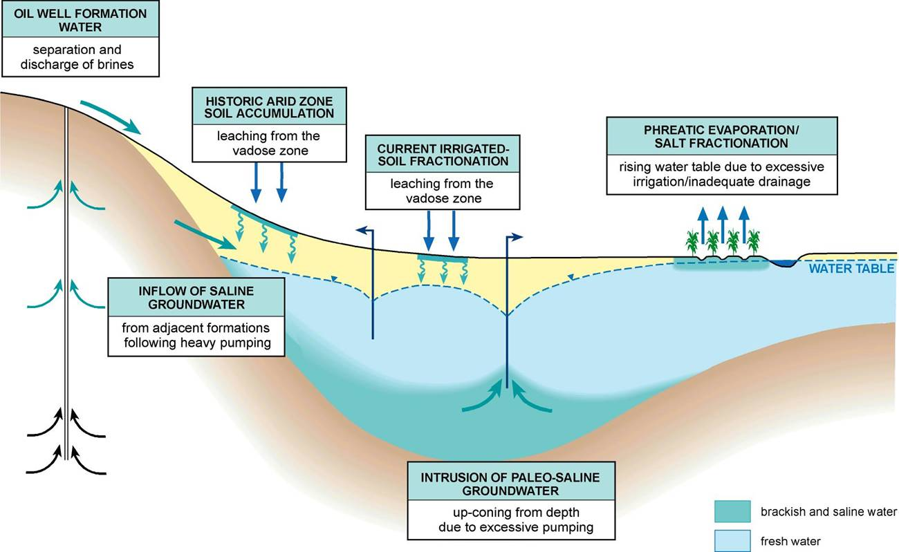
Ground Water
Notes:
conc
integrated data – common for the setting – from and for qll the water use sectors
water return- discharge components
- incorporate the water use – from each sector
and the discharge and it importance within the cycle.
- issue/problem – decide on HYDROLOGIC scale and context needed

Slide 16
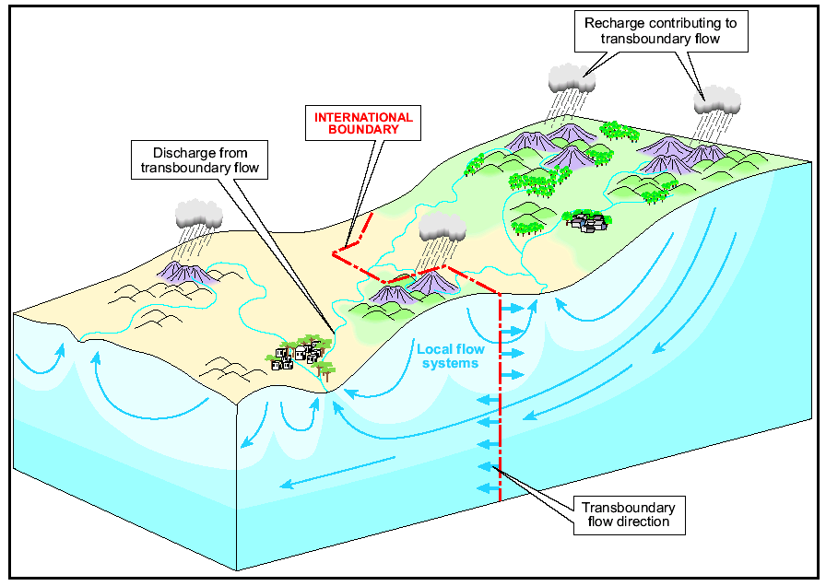
Watersheds – boundaries and divides ?
Country 1
Country 3
Country 2

Slide 17
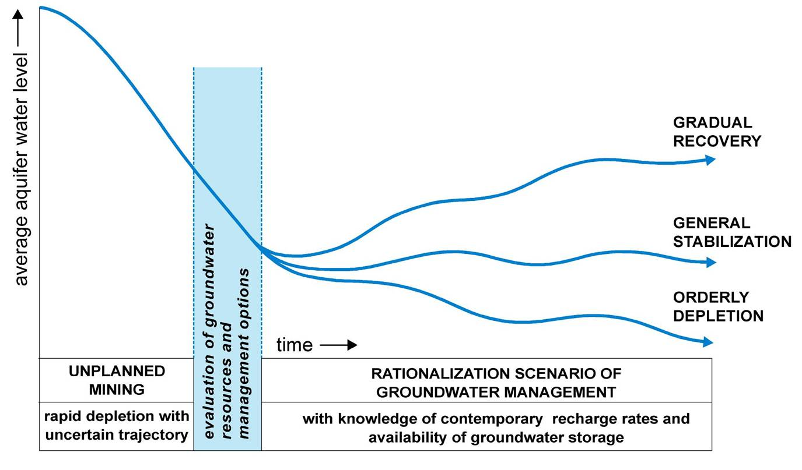
3. Ground Water Comments
Notes:
conc
integrated data – common for the setting – from and for qll the water use sectors
water return- discharge components
- incorporate the water use – from each sector
and the discharge and it importance within the cycle.
- issue/problem – decide on HYDROLOGIC scale and context needed

Slide 18
Alternatives: Re-use & conservation
Water reuse – stigma over effluents:
  success fundamentals openly addressed.
  show where & how it can be applied without risk.
Water conservation has minimal appeal in developed countries (perceived as a no need issue).
  commonly dismissed & little academic interest.
  not a fundable research area except post-crises
  (to see how LA reacts to its 22% cutback).
Water minimization in industry and agriculture:
  are there economic/political/societal incentives ?
Notes:
Asano – Noble Water Laureate -

Slide 19
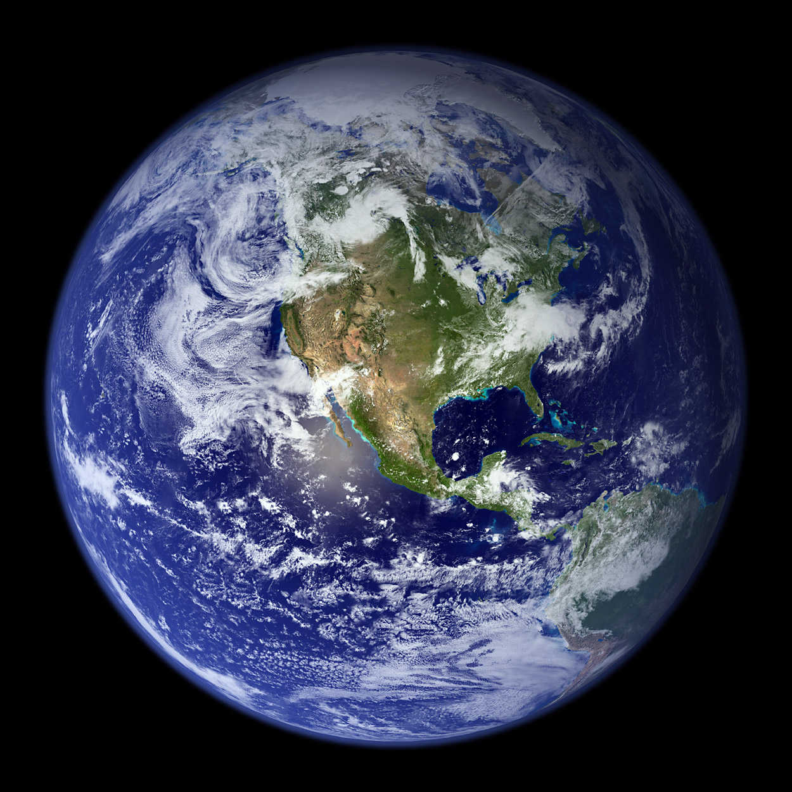
Overview
- Freshwater scarcity & pollution
- The water footprint of products
- National water footprint accounting
- The water footprint of a business
- WF sustainability assessment
- Response: reducing water footprints
- Water Footprint Network
Notes:
19

Slide 20
Freshwater scarcity and pollution
Notes:
20

Slide 21
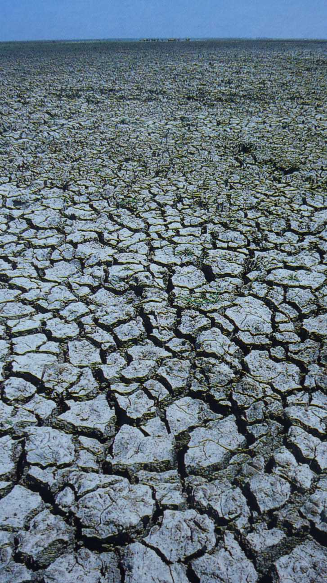
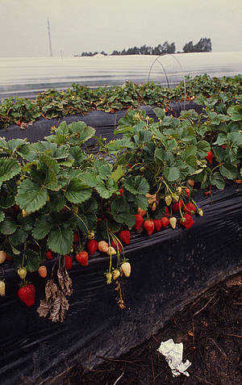
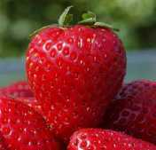
Signs of global water scarcity
Strawberries for export
Coto Doñana National Park, southern Spain
Notes:
21

Slide 22
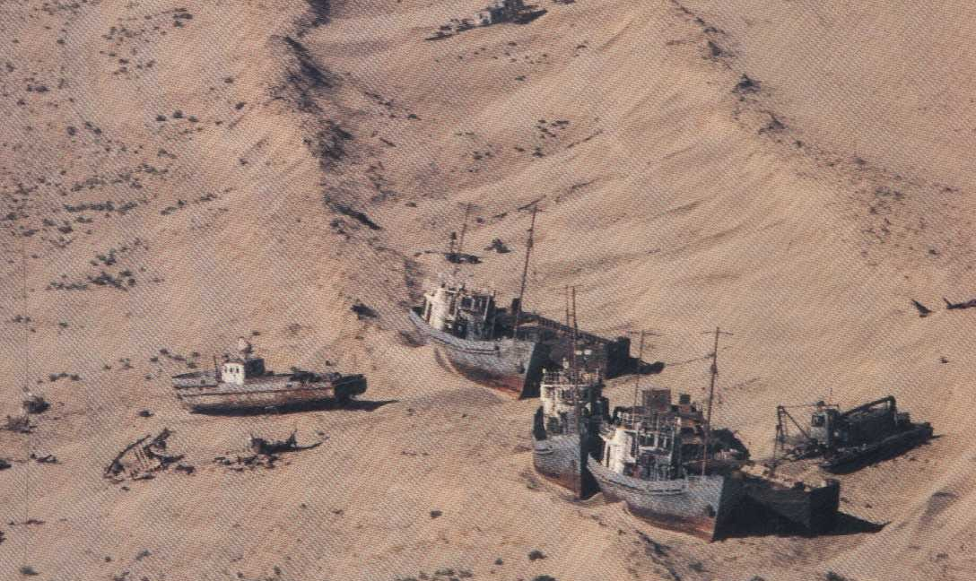
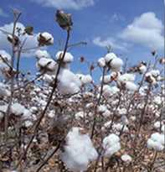
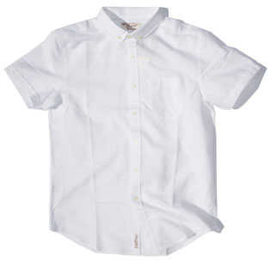
Signs of global water scarcity
Cotton for export
Former Aral Sea, Central Asia
Notes:
22

Slide 23
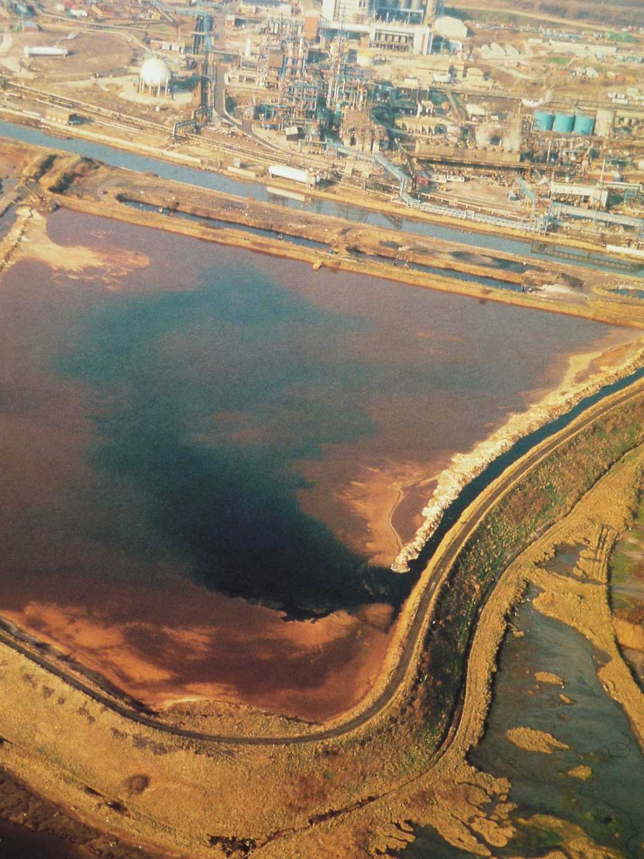
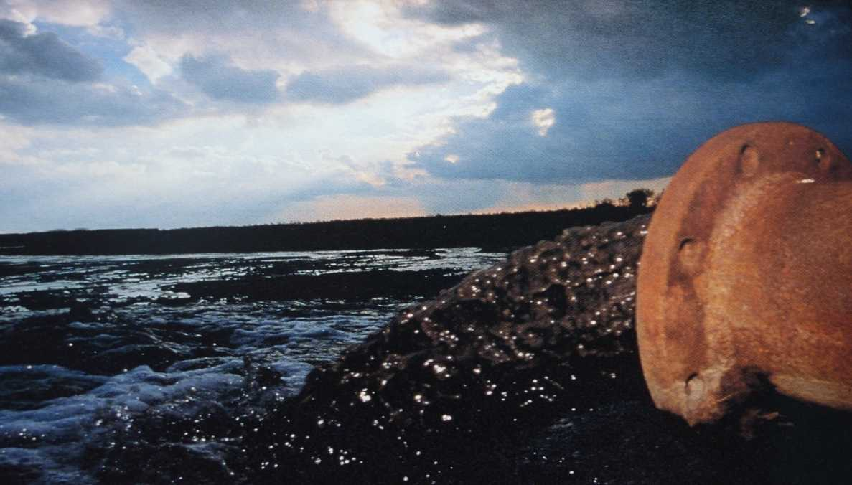
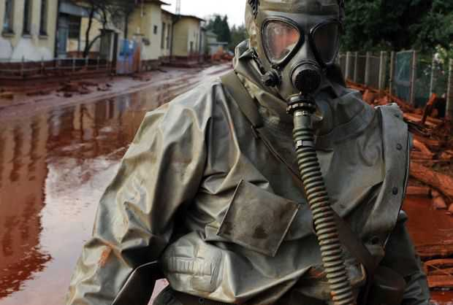
Signs of global water pollution
Devecser, Hungary, Oct. 5, 2010
Notes:
23

Slide 24
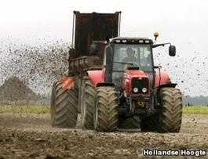
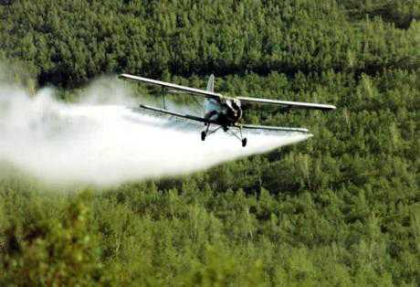
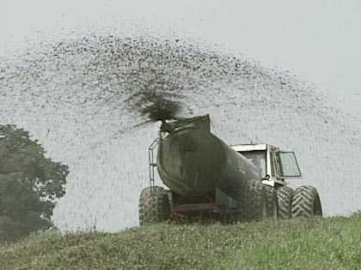
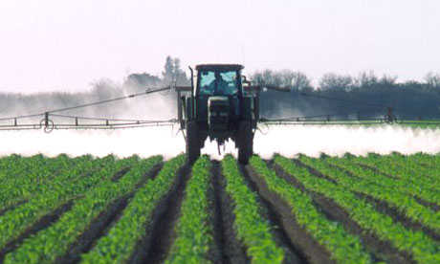
Signs of global water pollution
Notes:
24

Slide 25
The water footprint of a product
Notes:
25

Slide 26

The water footprint of a product
► the volume of fresh water used to produce the product, summed over the various steps of the production chain.
► when and where the water was used:
a water footprint includes a temporal and spatial dimension.
Notes:
26
The water footprint of a product (a commodity, good or service) is the total volume of freshwater used to produce the product, summed over the various steps of the production chain. The water footprint of a product refers not only to the total volume of water used; it also refers to where and when the water is used.
Source:
Hoekstra, A.Y., Chapagain, A.K., Aldaya, M.M. and Mekonnen, M.M. (2011) The water footprint assessment manual: Setting the global standard, Earthscan, London, UK.
See page 195.

Slide 27
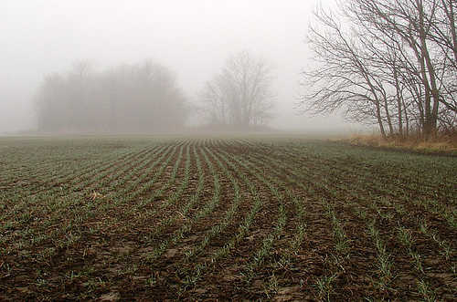
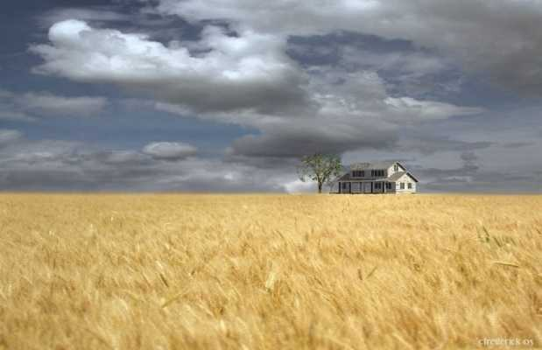
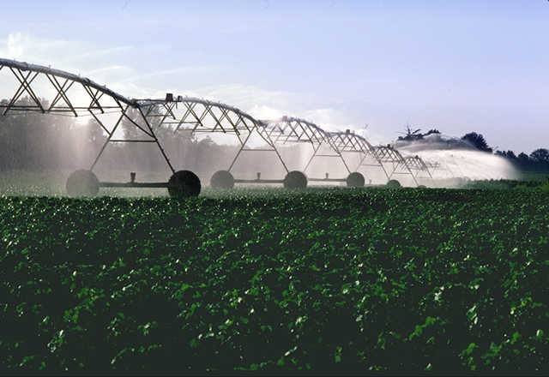
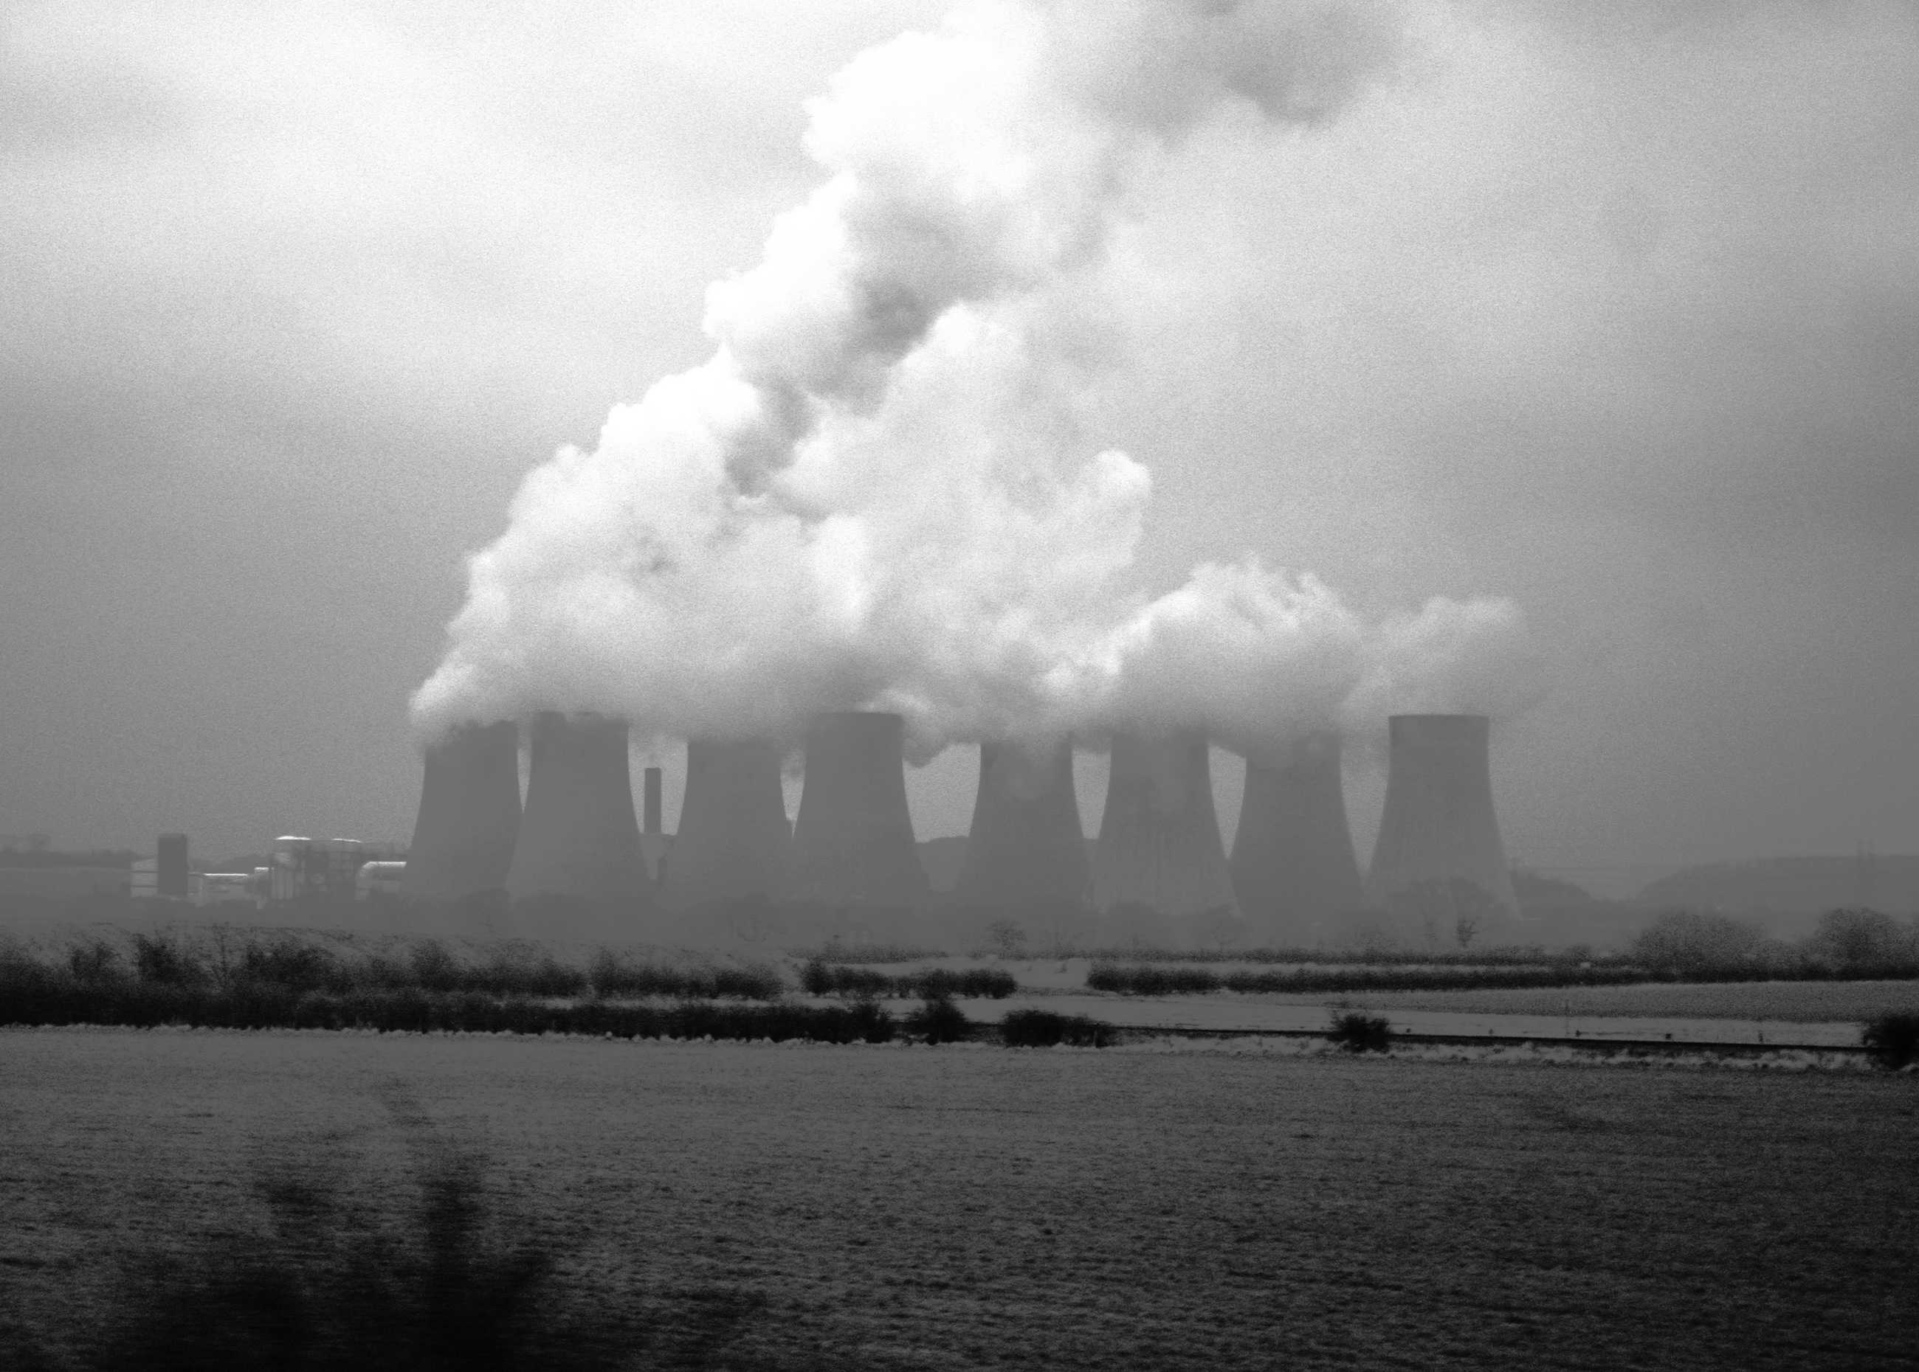
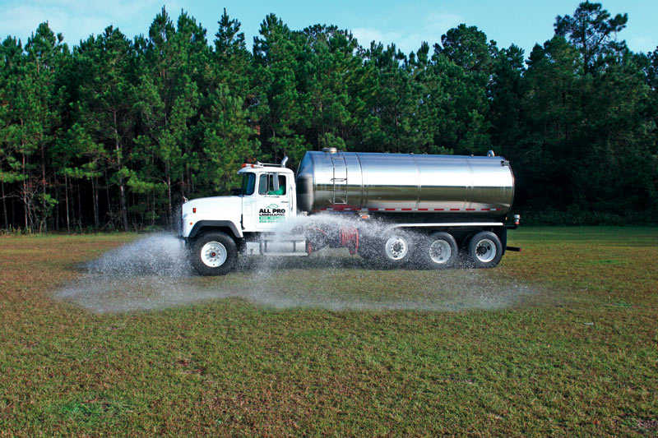
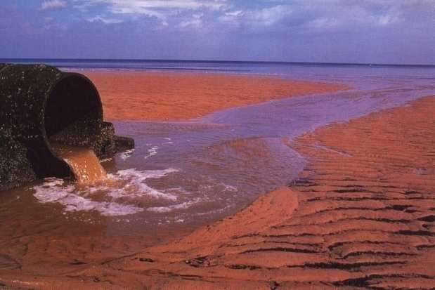
The water footprint of a product
Green water footprint
► volume of rainwater evaporated or incorporated into product.
Blue water footprint
► volume of surface or groundwater evaporated,
incorporated into product or returned to other catchment or the sea.
Grey water footprint
► volume of polluted water.
Notes:
27
Green water footprint – Volume of rainwater consumed during the production process. This is particularly relevant for agricultural and forestry products (products based on crops or wood), where it refers to the total rainwater evapotranspiration (from fields and plantations) plus the water incorporated into the harvested crop or wood.
Blue water footprint – Volume of surface and groundwater consumed as a result of the production of a good or service. Consumption refers to the volume of freshwater used and then evaporated or incorporated into a product. It also includes water abstracted from surface or groundwater in a catchment and returned to another catchment or the sea. It is the amount of water abstracted from groundwater or surface water that does not return to the catchment from which it was withdrawn.
Grey water footprint – The grey water footprint of a product is an indicator of freshwater pollution that can be associated with the production of a product over its full supply chain. It is defined as the volume of freshwater that is required to assimilate the load of pollutants based on natural background concentrations and existing ambient water quality standards. It is calculated as the volume of water that is required to dilute pollutants to such an extent that the quality of the water remains above agreed water quality standards.
Source:
Hoekstra, A.Y., Chapagain, A.K., Aldaya, M.M. and Mekonnen, M.M. (2011) The water footprint assessment manual: Setting the global standard, Earthscan, London, UK.
See page 187, 189, 190.

Slide 28
Components of a water footprint
Direct water footprint
Indirect water footprint
Water
consumption
Green water footprint
Green water footprint
Water withdrawal
Return flow
Blue water footprint
Blue water footprint
Water
pollution
Grey water footprint
Grey water footprint
The traditional
statistics
on water use
[Hoekstra et al., 2011]
Notes:
28
Water footprint – The water footprint is an indicator of freshwater use that looks at both direct and indirect water use of a consumer or producer.
Green water footprint – Volume of rainwater consumed during the production process. This is particularly relevant for agricultural and forestry products (products based on crops or wood), where it refers to the total rainwater evapotranspiration (from fields and plantations) plus the water incorporated into the harvested crop or wood.
Blue water footprint – Volume of surface and groundwater consumed as a result of the production of a good or service. Consumption refers to the volume of freshwater used and then evaporated or incorporated into a product. It also includes water abstracted from surface or groundwater in a catchment and returned to another catchment or the sea. It is the amount of water abstracted from groundwater or surface water that does not return to the catchment from which it was withdrawn.
Grey water footprint – The grey water footprint of a product is an indicator of freshwater pollution that can be associated with the production of a product over its full supply chain. It is defined as the volume of freshwater that is required to assimilate the load of pollutants based on natural background concentrations and existing ambient water quality standards. It is calculated as the volume of water that is required to dilute pollutants to such an extent that the quality of the water remains above agreed water quality standards.
As an indicator of ‘water use’, the water footprint differs from the classical measure of ‘water withdrawal’ in three respects:
1. It does not include blue water use, in so far as this water is returned to where it came from.
2. It is not restricted to blue water use, but also includes green and grey water.
3. It is not restricted to direct water use, but also includes indirect water use.
Source:
Hoekstra, A.Y., Chapagain, A.K., Aldaya, M.M. and Mekonnen, M.M. (2011) The water footprint assessment manual: Setting the global standard, Earthscan, London, UK.
See page 3.

Slide 29
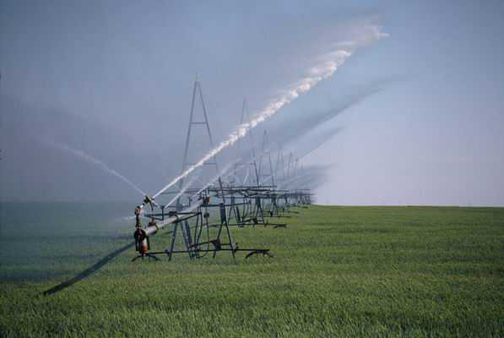
Crop water use
Green water evapotranspiration =
min (crop water requirement, effective precipitation)
Blue water evapotranspiration =
min (irrigation requirement, effective irrigation)
Notes:
29
Green water use refers to the volume of rainwater that evaporates from a crop field during the growing period. Blue water use refers to the volume of irrigation water (withdrawn from surface or ground water) that evaporates from a crop field during the growing period. The distinction between green and blue water has been introduced by Malin Falkenmark, Swedish hydrologist.

Slide 30
Irrigation requirement
Irrigation requirement = crop water requirement – effective rainfall
Notes:
30
When rainfall does not meet the crop water requirement, the gap is the irrigation water requirement. When the irrigation water requirement is supplied indeed, growing conditions are optimal (provided that other factors like nutrient availability are optimal as well). If the irrigation requirement is not met or only partly, the yield is likely to be lower than optimal. The yield reduction depends on the volumes and timing of the water shortages.
Picture: Pivot irrigation on cotton.

Slide 31
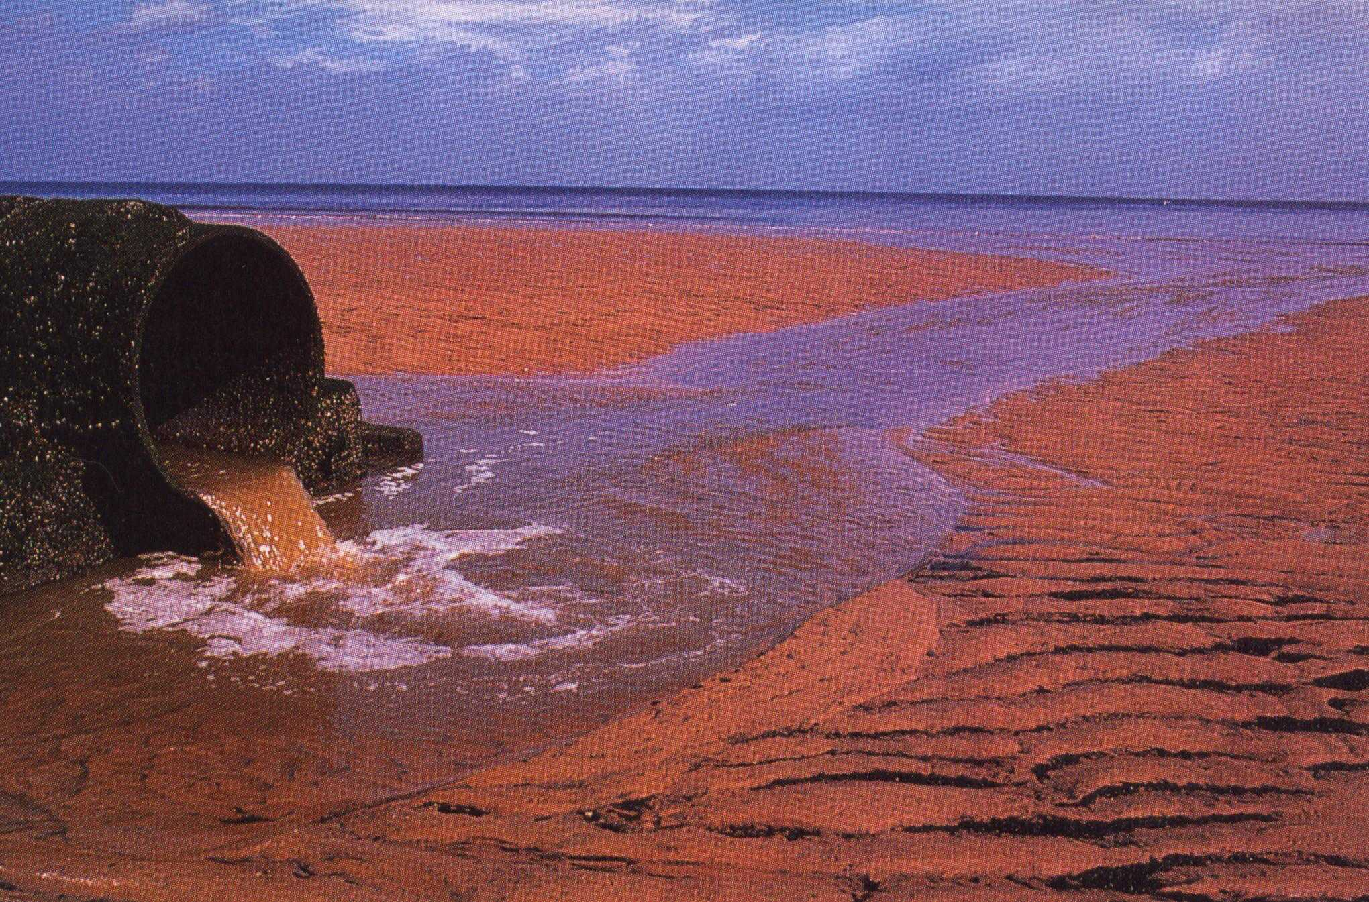
Grey water footprint
volume of polluted freshwater that associates with the production of a product in its full supply-chain.
calculated as the volume of water that is required to assimilate pollutants based on ambient water quality standards.
Notes:
31
The grey water footprint of a product of freshwater pollution that can be associated with the production over its full supply chain. It is defined as the volume of freshwater to assimilate the load of pollutants based on natural background and existing ambient water quality standards. It is calculated water that is required to dilute pollutants to such an extent the water remains above agreed water quality standards.
Source of photo: Cunningham et al. (2003) p.448-456

Slide 32
The water footprint:
making a link between consumption in one place and impacts on water systems elsewhere
Shrinking Aral Sea
Notes:
32
Water use for cotton production can have major impacts on the environment. Particularly intensive irrigation schemes can have disastrous effects, as shown for example in the case of Uzbekistan and the desiccation of the Aral Sea.

Slide 33
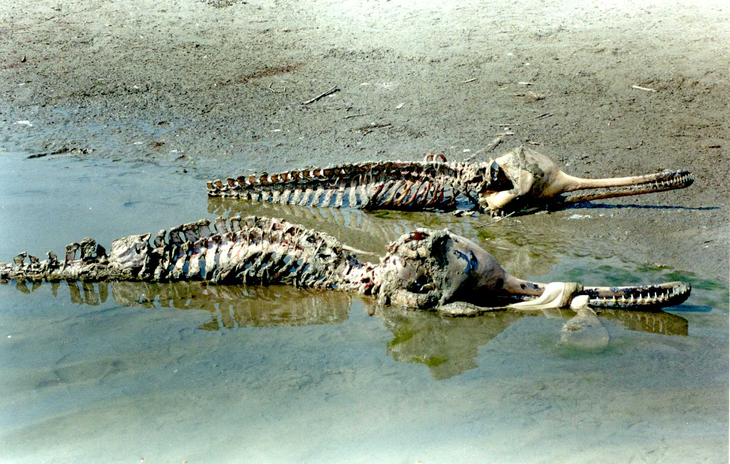
The water footprint:
making a link between consumption in one place and impacts on water systems elsewhere
Endangered Indus River Dolphin
[Photo: WWF]
Notes:
The Indus River dolphin (Platanista minor) is one of the world's rarest mammals and the second most endangered freshwater river dolphin. Approximately 1,100 specimens of this species exist today in a small fraction of their former range, the lower reaches of the Indus River in Pakistan. However, the population of this species has gradually declined because of various factors, including water pollution, poaching, fragmentation of habitat due to barrages, and dolphin strandings in the irrigation canals. (Source: WWF). Pollution (pesticide runoff) from mainly cotton.
Yangtze dolphin extinct, Indus severely threatened. Water for people and nature requires management which focuses on multiple needs of systems. WF analysis allows us to trace supply and identify impacts. It gives clear steer on risk and responsibility.

Slide 34

This is a global average and aggregate number. Policy decisions should be taken on the basis of:
1. Actual water footprint of certain coffee at the precise production location.
2. Ratio green/blue/grey water footprint.
3. Local impacts of the water footprint based on local vulnerability and scarcity.
[Hoekstra & Chapagain, 2008]
Notes:
It costs about 21,000 litres of water to produce 1 kg of roasted coffee. For a standard cup of coffee we require 7 gram of roasted coffee, so that a cup of coffee costs 140 litres of water. Assuming that a standard cup of coffee is 125 ml, we thus need more than 1100 drops of water for producing one drop of coffee. Drinking tea instead of coffee would save a lot of water. For a standard cup of tea of 250 ml we require 30 litres of water.

Slide 35
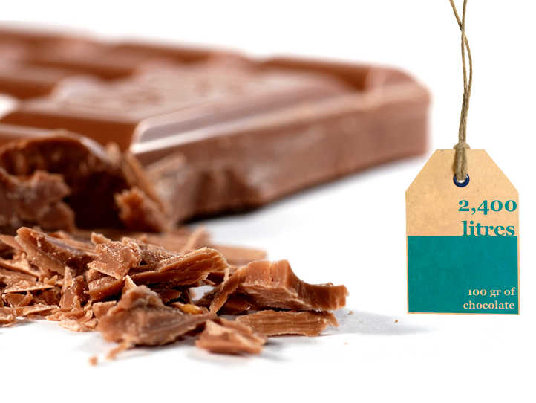
[Hoekstra & Chapagain, 2008]
Notes:
The water footprint of pure chocolate is 2400 litres for a 100-gram bar (as a world average!). Composition of dark chocolate: 40% cocoa paste (water footprint 33260 litres/kg); 20% cocoa butter (water footprint 50730 litres/kg); 40% sugar (water footprint 1526 litres/kg). We then can calculate: 40% 33260 + 20% 50730 + 40% 1526 = 24060 litres/kg = 2400 liters for one 100gr chocolate bar. The water footprint of milk powder is 4600 litres/kg, so that milk chocolate will have a bit larger water footprint (about 2500 litres for one 100gr chocolate bar) than dark chocolate when total cocoa content remains the same. Most crucial for the water footprint of chocolate is the cocoa paste and cocoa butter content.

Slide 36
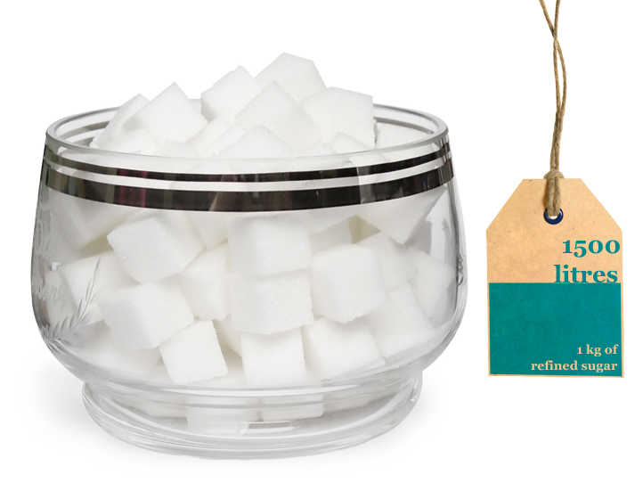
[Hoekstra & Chapagain, 2008]
Notes:
For 1 kg of refined sugar from SUGAR CANE we require about 1500 litres of water. Sugar cane consumes about 220 billion cubic meters of water annually, which is 3.4 % of the global water use for crop production. Sugar from sugar beets requires less water per kg.

Slide 37
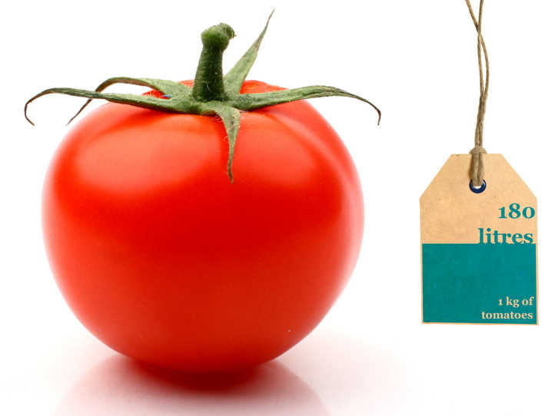
[Hoekstra & Chapagain, 2008]
Notes:
37

Slide 38

[Hoekstra & Chapagain, 2008]
Notes:
38

Slide 39
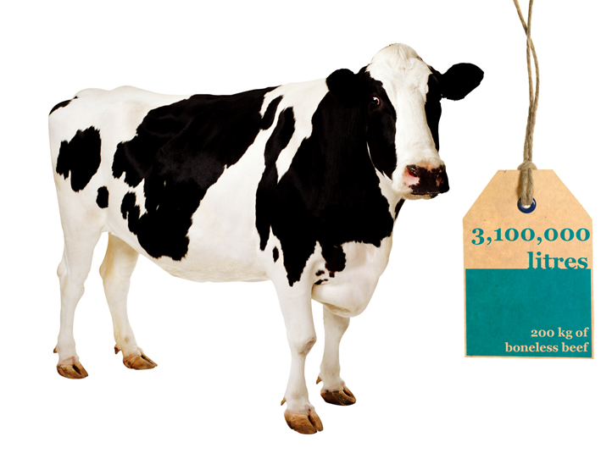

The water footprint of a cow
Food
► 1300 kg of grains
(wheat, oats, barley, corn, dry peas, soybean, etc)
► 7200 kg of roughages
(pasture, dry hay, silage, etc)
Water
► 24000 litres for drinking
► 7000 litres for servicing.
99%
1%
[Hoekstra & Chapagain, 2008]
Notes:
The water footprint of a beef cow is 3,100,000 litres. In an industrial beef production system, it takes in average three years before the animal is slaughtered to produce about 200 kg of boneless beef. The animal consumes nearly 1300 kg of grains (wheat, oats, barley, corn, dry peas, soybean meal and other small grains), 7200 kg of roughages (pasture, dry hay, silage and other roughages), 24 cubic meter of water for drinking and 7 cubic meter of water for servicing. This means that to produce one kilogram of boneless beef, we use about 6.5 kg of grain, 36 kg of roughages, and 155 litres of water (only for drinking and servicing). Producing the volume of feed requires about 15300 litres of water in average.

Slide 40
[Hoekstra & Chapagain, 2008]
Notes:
The water footprint of a beef cow is 3,100,000 litres. In an industrial beef production system, it takes in average three years before the animal is slaughtered to produce about 200 kg of boneless beef. The animal consumes nearly 1300 kg of grains (wheat, oats, barley, corn, dry peas, soybean meal and other small grains), 7200 kg of roughages (pasture, dry hay, silage and other roughages), 24 cubic meter of water for drinking and 7 cubic meter of water for servicing. This means that to produce one kilogram of boneless beef, we use about 6.5 kg of grain, 36 kg of roughages, and 155 litres of water (only for drinking and servicing). Producing the volume of feed requires about 15300 litres of water in average.

Slide 41
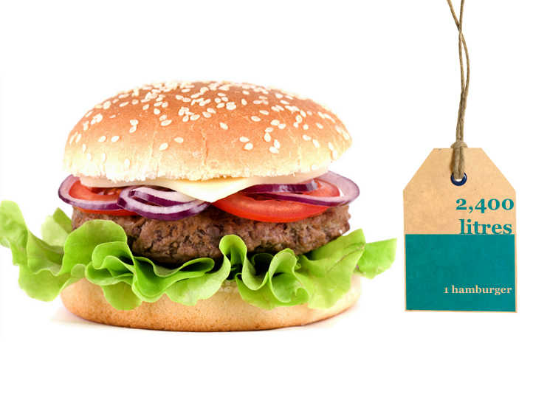
[Hoekstra & Chapagain, 2008]
Notes:
The major part of the water footprint of a hamburger refers to the water needed to make the feed for the cow.

Slide 42

[Hoekstra & Chapagain, 2008]
Notes:
Water footprint: 10 litres of water for one A4-sheet of paper. We assume here eighty-grams paper (80g/m2). Further we assume that the paper is produced from wood.
Sources:
Hoekstra, A.Y. and Chapagain, A.K. (2008) Globalization of water: Sharing the planet's freshwater resources, Blackwell Publishing, Oxford, UK.
Van Oel, P.R. and Hoekstra, A.Y. (2010) The green and blue water footprint of paper products: methodological considerations and quantification, Value of Water Research Report Series No.46, UNESCO-IHE, Delft, the Netherlands.

Slide 43
Water footprint of a consumer
► the total volume of water appropriated for the production of the goods and services consumed.
► equal to the sum of the water footprints of all goods and services consumed.
► dimensions of a water footprint
volume
where and when
type of water use: green, blue, grey
Notes:
43

Slide 44
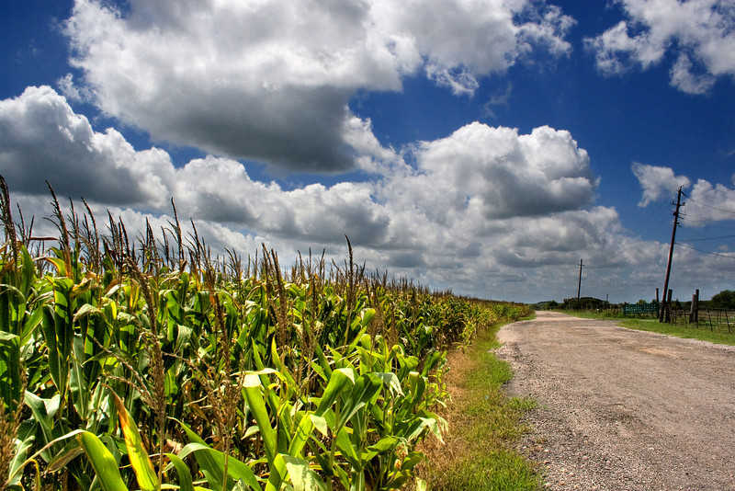
Make better use of ‘green water’
Increase water productivity in
rain-fed
agriculture
Notes:
44
Photo: wheat field.

Slide 45
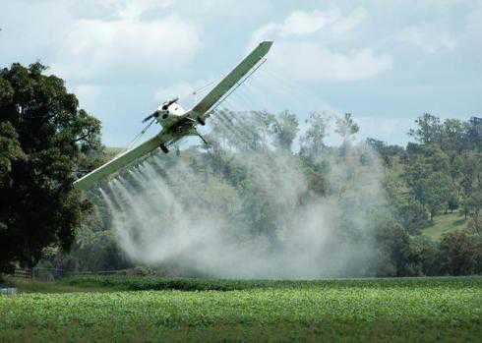

Grey water footprint ↓ zero
Towards organic farming
Towards zero emission
Notes:
45

